Slide 1
CSC 101 – Introduction to Computing
Lecture 13

Slide 2
Outline
E-commerce:
Overview
E-commerce Basics
Business Applications
Global Trends;
Impacts: Impacts on Market & Retailers
Impact on Supply Chain Management
Impact on Employment
Impact on Customers
Impact on Environment
Impact on Traditional Retail
Impact on Distribution Channels

Slide 3
What Is E-Commerce?
E-Commerce
The act of doing business transactions over the Internet or similar technology
Has existed for years via private networks (electronic funds transfers, etc.)
Now most often performed via the Internet
Dot-com
An Internet-only store with no physical presence
Brick-and-Mortar Store
A conventional store with a physical presence

Slide 4
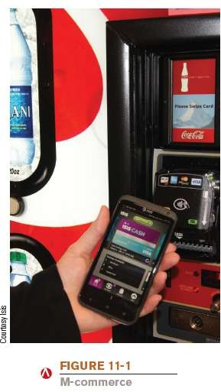
What Is E-Commerce?
M-Commerce
E-commerce carried out via smartphones and other mobile devices
Near Field Communications (NFC) uses RFID to facilitate communications between devices

Slide 5
Advantages of E-Commerce
For Businesses
Reduced costs
Dot-coms are less expensive than brick-and-mortar stores because there is no physical storefront to maintain
Increased customer satisfaction
Shopping experience is convenient (open all the time, no driving, etc.)
Can send customers personalized information
Broader customer base (less geographical restrictions)
Potentially higher sales

Slide 6
Advantages of E-Commerce
For Customers
Convenience
Higher degree of selection
Easier comparison shopping
Higher number of merchants to choose from
Geographical location is not an issue
Shopping bots and other comparison shopping tools are available
Potential cost savings
Customized products

Slide 7
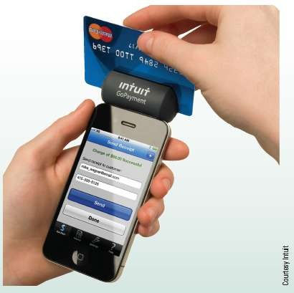
Technology and You Box
Mobile Payments
You can make purchases and send money to others via a mobile device
Mobile payment processing allows payments (typically credit card payments) to be collected via a mobile device
Field workers
Craft vendors
Sales personnel

Slide 8
Disadvantages of E-Commerce
For Businesses
Pressure to be always open, site always working
Solid, well designed sites and hosting
Lost business due to some customer hesitation to shop online
Risk of fraudulent credit card transactions
Ease of entry for competitors

Slide 9
Disadvantages of E-Commerce
For Customers
Potential for fraud and other potential security problems
Buyer protection programs and using
credit card protection can help
Not being able to see or touch the goods
3D online stores may help
Possible expense of returning merchandise
Some click-and-mortar stores allow returns to local stores

Slide 10
E-Commerce Business Models
Business-to-Consumer (B2C) Business Model
An e-commerce model in which a business provides goods or services to consumers
Business-to-Business (B2B) Business Model
An e-commerce model in which a business provides goods or services to other businesses
Intermediary Hubs
Bring buyers and sellers together
Vertical hubs
Horizontal hubs

Slide 11
E-Commerce Business Models
Consumer-to-Consumer (C2C) Business Model
An e-commerce model in which a consumer provides goods or services to other consumers
Craigslist and online auctions are common means of C2C transactions
Business-to-Government (B2G) Business Model
An e-commerce model in which a business provides goods and services to government organizations
Businesses or individuals paying taxes online etc. can be
viewed as G2B and G2C transactions, respectively

Slide 12
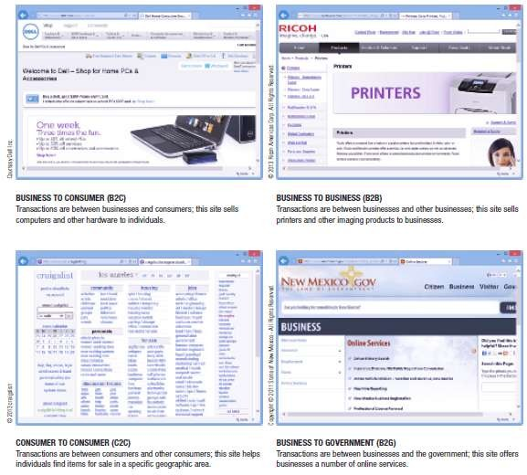

E-Commerce Business Models

Slide 13
Business Applications
Manufacturer and E-Tailer Sites
Manufacturers and online retailers sell directly to customers via their Web sites
Subscription Sites
Sells access to its online content
Newspapers and journals
E-book rentals
Premium social networking services

Slide 14
Business Applications
Brokerage Sites
Bring buyers and sellers together and earn revenue by charging commissions on sales made via the site
Online Auctions
Financial Brokerages
Allow individuals to sell stocks, bonds, futures, etc.
Generate revenue by charging commissions or transaction fees
Real Estate, Travel, and Other Consumer Brokerages
Assist consumer in finding resources they desire
Real estate
Airline tickets
Hotel reservations

Slide 15
E-commerce Trends
The global ecommerce market is expected to total $5.55 trillion in 2022
Global retail sales growth will continue to rise and take up more retail market share
According to eMarketer, online retail sales will reach $6.17 trillion by 2023
China is accounting for 52.1% of all retail ecommerce sales worldwide
Latin America saw $85 billion in ecommerce sales in 2021
The Indian ecommerce market is expected to grow to $111.4 billion by 2025
Russia, the UK, and the Philippines saw more than 20% ecommerce sales growth in 2021.

Slide 16
E-commerce Trends
Mobile shopping and social commerce
Online retail continues to expand due to the increasing use of smartphones and tablets globally
30% of US consumers report purchasing goods through social platforms
The metaverse and interactive shopping
Brands are betting on virtual shopping and experimenting with augmented and virtual reality retail
Language localization

Slide 17
Impact on markets and retailers
E-commerce markets are growing at noticeable rates
Traditional markets are reported slow growth as compared to online business
Online and traditional markets have different strategies for conducting business
Traditional Business | Online Business
Geographical Barrier | Over Come Geographical Barriers
Prices to cover cost of keeping inventory | Pricing based on speed of delivery
Few products due to shelf space | Warehouses, sometime have no inventory, but send customer order number to manufacturer

Slide 18
Impact on Supply Chain management
Increase warehouse capacity and customer proximity: The closer your warehouses are to customers, the faster you can fulfill orders directly to consumers or brick-and-mortar retailers.
Lower the cost of shipping: shipping deals for orders over a certain price, as well as incentives to bundle items, such as price discounts and free shipping.
Integrate an order management system: The end-to-end order management process is automated, working hand-in-hand with each link of the supply chain to guarantee customer satisfaction.
Kit items: Kitting items is the process of automatically manufacturing and storing bundled items together.
Automated Invoice: With online invoicing, your customers can pay online and access all important payment documentation whenever they need to.

Slide 19
Impact on Employment
Increased Demand for Worker
Remote sales agents
Technology provides workers with an upper hand
The continual growth of the e-commerce sector has fueled the development of new technology.
Omnichannel sales and recruitment
Omnichannel selling means accessing consumers at every point, both online and offline. Many established stores have taken advantage of this and launched online shopping experiences to mimic the ones found in their stores.

Slide 20
Impact of E-commerce on Customers
Increased customers
Convenience
Availability
E-commerce lacks human interaction for customers
Customers are also concerned with the security of online transactions and tend to remain loyal to well-known retailers

Slide 21
Impact of E-Commerce on Environment
Transportation emissions
E-commerce business models allow for organizations to conduct business without physically commuting.
work from home
Paper waste
When information is transferred digitally, it reduces the need for the use of physical paper throughout the business.
Digital storage
The digital transfer of information paired with digital manufacturing could eliminate warehouses and create on-demand production.

Slide 22
Impact of E-commerce on Traditional Business
Elimination of middlemen: Businesses can sell directly to the customers
Marketing: The rise in e-commerce, digital marketing has replaced traditional marketing methods.
Higher Profits: 24*7 availability and convenience has resulted in huge profits.
Global marketplace: All the customers from overall the world can access your products by simply sitting at home.

Slide 23
Impact of E-Commerce on Distribution Channels
Evolving Channels
The end of old distribution channels mainly had the consumer purchasing a product by visiting a physical retail location. Increasingly customers now expect the product to come directly to them.

Slide 24
Summary
E-commerce:
Overview
E-commerce Basics
Business Applications
Global Trends;
Impacts: Impacts on Market & Retailers
Impact on Supply Chain Management
Impact on Employment
Impact on Customers
Impact on Environment
Impact on Traditional Retail
Impact on Distribution Channels

